Slide 1

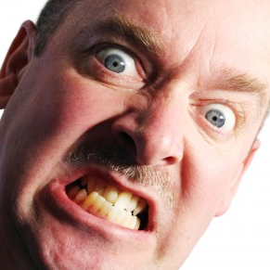
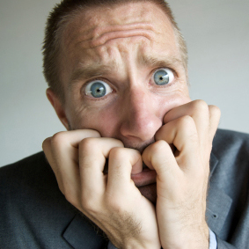
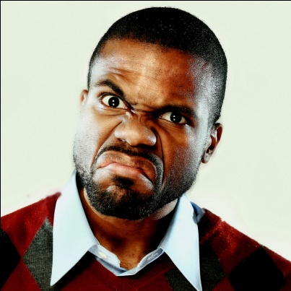
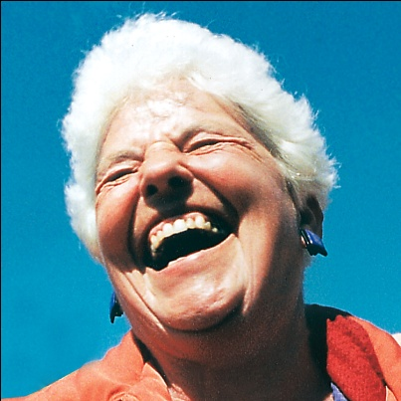

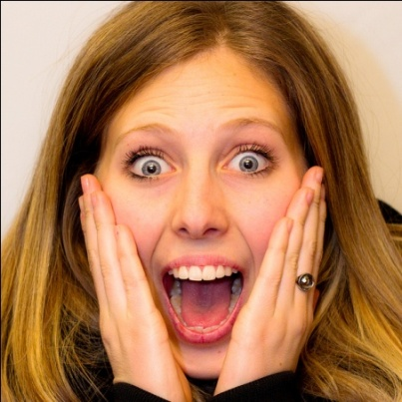
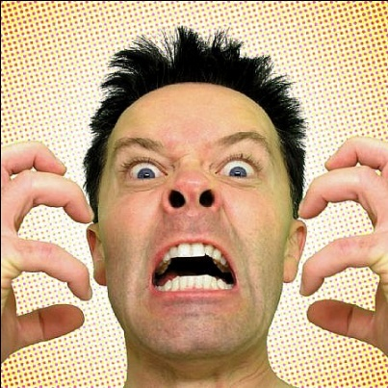
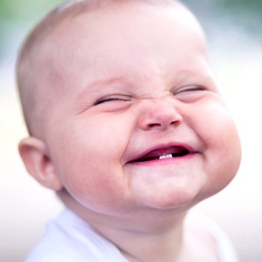
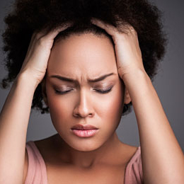

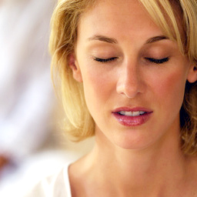
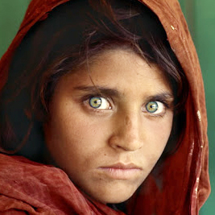

Emotional
Intelligence
Through Laughter Yoga

Slide 2
Ask yourself a Question ?
How is your WILL POWER?
Do you have difficulty in giving
up bad habits.

Slide 3
Ask your self a Question ?
Are you very Emotional
and sensitive person.
Do you get hurt easily?

Slide 4
Ask yourself a Question ?
When someone hurts you
do you keep thinking
about it for hours and days

Slide 5
Ask yourself a Question ?
Do you feel like eating
when you see the food
SEA FOOD

Slide 6
Ask yourself a Question ?
Did Ever made Impulsive
decision and regret later ?

Slide 7
Ask yourself a Question ?
Do you get angry when verbally attacked?

Slide 8
Ask yourself a Question ?
Do you get anxious about
some situations often?

Slide 9
Ask yourself a Question ?
Do you feel stressed out and depressed often?

Slide 10
Ask yourself a Question ?
Do you want to overcome challenges in your life with a smile on your face?

Slide 11
Ask yourself a Question ?
Do you want to master how to diffuse conflicts with people?

Slide 12
Ask yourself a Question ?
Do you want to build healthy relationship with people?

Slide 13
Ask yourself a Question ?
Do you want to communicate effectively with people?

Slide 14
Ask yourself a Question ?
Do you achieve success, satisfaction peace and harmony?

Slide 15
YOU IN THE RIGHT SEMINAR
YOU NEED TO HAVE
EMOTIONAL INTELLIGENCE

Slide 16
Why Do We Need Emotions?
To meet Basic Survival Needs
Food
Shelter
Clothes
Good Health
Security
Wi Fi

Slide 17
Why Do We Need Emotions?
Emotional Needs
Love
Care
Appreciation
Acknowledgement

Slide 18
Why Do We Need Emotions?
Pleasures and Comforts
Enjoyment
Freedom
Peace
Harmony

Slide 19
Why Do We Need Emotions?
What we DON’T want
Discomfort
Pain
Criticism
Obstacles to fulfillment of goals

Slide 20
What is an EMOTION ?
E and Motion
Energy that moves our body and mind to take some action
To do something to get what is most important in our lives
To keep away what comes in way of your fulfillment

Slide 21
How We Generate Emotions ?
Sources of Thoughts
External World
(Objects, People and Events)
Internal World
Past Experiences stored in Subconscious mind
Thoughts Emotions
Intellect
(Reasoning and Judging Ability)
Emotions Physiological reactions in the body Feelings

Slide 22
FEELINGS AND EMOTIONS
Emotions are external expressions of feelings
Feelings are internal perceptions of emotions.
Feelings are the mental impressions of what happened during emotional experience
Feelings is a belief system and conditioning which arise out of repeated emotional experiences.
Emotions and Feelings has cause and effect relationship and they run in a circle

Slide 23
EMOTIONS AND FEELINGS
JOY HAPPINESS
FEAR WORRY
ANGER BITTERNESS
SADNESS DEPRESSION

Slide 24
What is Emotional Intelligence ( EI)
Emotional intelligence is the ability to identify, understand, and manage
YOUR EMOTIONS
EMOTIONS OF OTHERS
Build strong relationships at home and work, and achieve your goals

Slide 25
What is Emotional Intelligence ( EI)
Emotions are very powerful tools that define success or failure in every aspect of your life.
They can take you to the heights of excitement or the depths of depression. Emotions are like fire, they can cook the food, they can burn the house.

Slide 26
What is Emotional Intelligence ( EI)
EI is your ability to use your emotions in the right way to get the right results to satisfy your needs and wants.
EI is how to respond appropriately and not reacting impulsively.

Slide 27
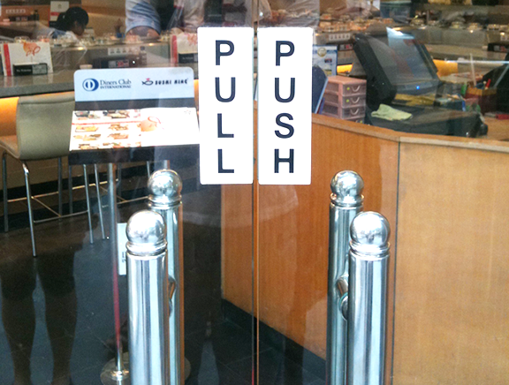
When to Express and when to keep quiet
Emotional Intelligence is
When to PULL & when to PUSH

Slide 28
Emotional Intelligence (EQ) /Intelligence Quotient (IQ)
IQ only accounts for about 20% of our success
EQ accounts for 80% of our Success
IQ can get you a Job
EQ decides If you will be fired or get Promotion
Most university toppers work for those who are not good in academics. Politicians command most intelligent bureaucrats.

Slide 29
Types of Emotions
Positive emotions
Feelings of pleasure love and happiness
Draws people closer to you
Negative emotions
Brings discomfort, pain
Drives people away or you run away

Slide 30
How We Express Emotions
Emotional thoughts
Emotional speech
Emotional action or behavior

Slide 31
What do we do with Emotions
Express Emotions
Suppress Emotions
Process Emotions

Slide 32
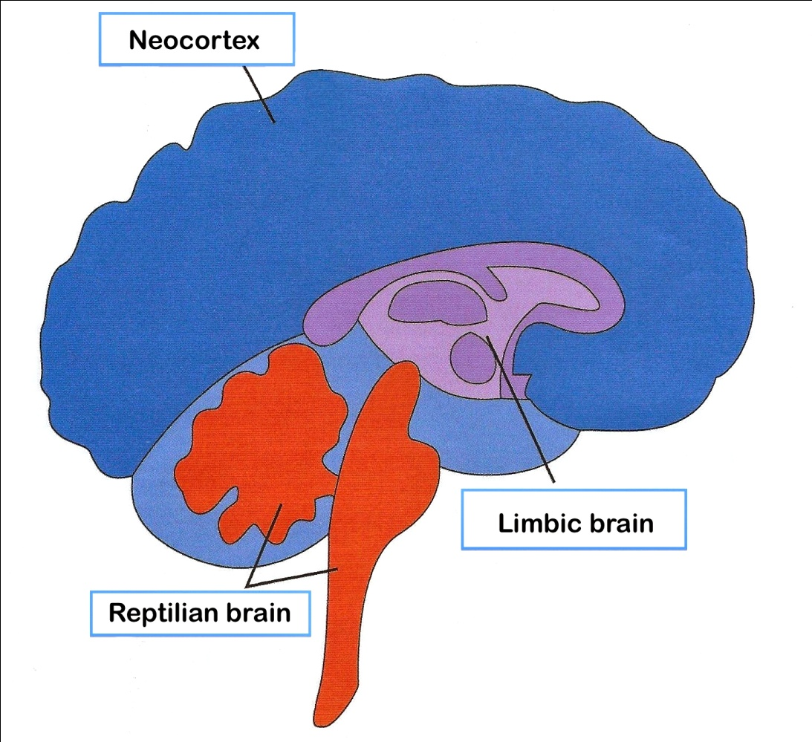
3 Types Of Brain
Reptilian Brain
Emotional Brain
Neo-cortex ( Smart Brain)

Slide 33
Four Core Abilities Of Emotional Intelligence
1. Self-awareness
Recognize your own emotions and how they affect your thoughts and behavior, know your strengths and weaknesses, and have self-confidence.
2. Self-management
Control impulsive feelings & behaviors, manage your emotions in healthy ways, take initiative, follow through on commitments, and adapt to changing circumstances.

Slide 34
Four Core Abilities Of Emotional Intelligence
3. Social awareness
Understand emotions, needs, and concerns of other people, and help them feel comfortable.
4. Relationship management
Develop and maintain good relationships, communicate clearly, inspire and influence others, work well in a team, and manage conflict.

Slide 35
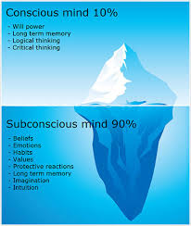
Talking to yourself
Conscious Mind
INTELLECTUAL MIND
Subconscious
Unconscious Mind

Slide 36
Talking to Yourself
What is your Identity
Actor inside me
Spectator inside me

Slide 37
Talking to Yourself
What you say is the way
Talking to Your Conscious Mind
Pretend as if everything going to be OK ( EGBOK EGBOK YAY!!!)
Talking to your Subconscious Mind because subconscious mind does know the difference between imagination and reality.
I am different than my mind

Slide 38
Talking to Yourself
Challenge Your Assumptions
Default Mode Thinking is passive thinking. Thoughts coming randomly without active thinking.
Counter Thoughts

Slide 39
Talk to Yourself Emotional Scan (Reality Check)
When you are about to take some action and have time to think. Rationalizing Your Emotions
Is this really important to me? If so, which part of me—my ego self or true self?
Are my expectations realistic?
Is this a trivial issue or is this a serious issue, one that deserves this much emotion and concern
4. What are the consequences if I do—or don’t act on this emotion?
5. Is there a solution with the greatest good for all?

Slide 40
Difference Between Needs And Wants
NEEDS are absolutely necessary for survival
WANTS : I would like to have if have resources, mostly for pleasures and comforts
Please Identify your needs & wants

Slide 41
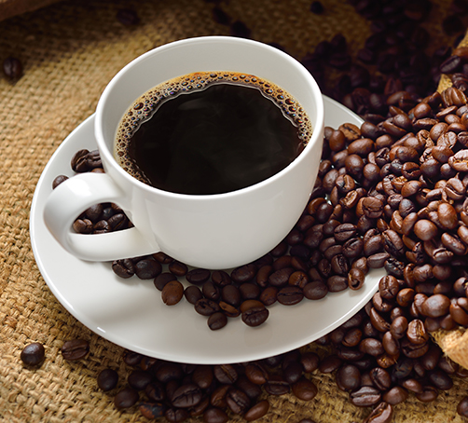
You Limit Your Caffeine Intake
Drinking excessive amounts of caffeine triggers the release of adrenaline, and adrenaline is the source of the fight-or-flight response.
When caffeine puts your brain and body into this hyper-aroused state of stress, your emotions overrun your behavior.
High-EQ individuals know that caffeine is trouble, and they don’t let it get the better of them.

Slide 42

You Know How to Say No (to Yourself and Others)
Saying no is indeed a major self-control challenge for many people.
“No” is a powerful word that you should not be afraid to say “NO”.
Saying “No” to a new commitment honors your existing commitments and gives you the opportunity to successfully fulfill them.

Slide 43
Spiritual Tools for Emotional Intelligence
UNDERSTANDING SPIRITUALITY
SPIRITUAL VALUES
SPIRITUAL LAWS

Slide 44
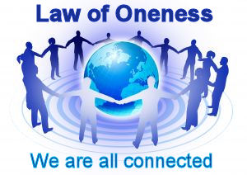
Spiritual Law of Oneness
Everyone belongs to me and belong to everyone

Slide 45
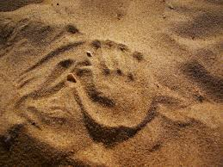
Spiritual Law of Impermanence
Life is a Change Everything is Changing,
Nothing is Permanent

Slide 46

Spiritual Law of Imperfection
Emotionally intelligent people won’t set perfection as their target because they know that it doesn’t exist.
Seeing beauty in imperfection is japanese art of wabi sabi
Imperfections put together makes perfection

Slide 47
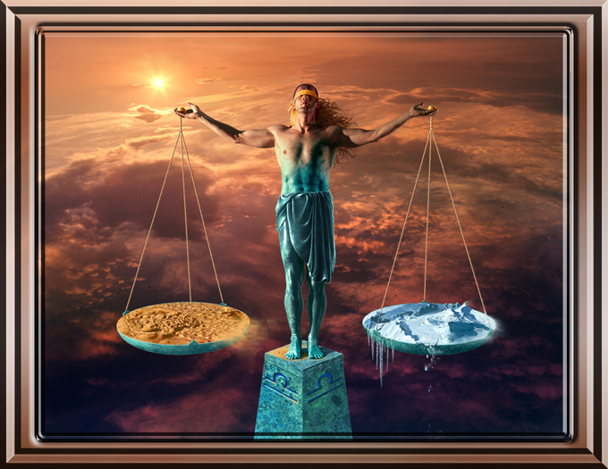
Spiritual Law of Karma
Every Action has equal and opposite reaction
You are the Master of your destiny. What you do comes back.
We have no control over what happens to us. But we have 100% control on what we do when something happens.

Slide 48
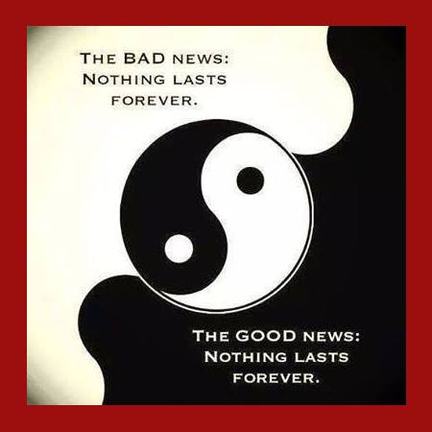
Spiritual Law of Opposites
Life is a blend of Laughter and tears.
Happiness Sorrow, Good and Bad is a design of life.
No one state of being lasts for ever. Good or bad things will go away.

Slide 49
For Living Stress Free Life ?
As
Be Real and Be Authentic,
Don’t Pretend

Slide 50
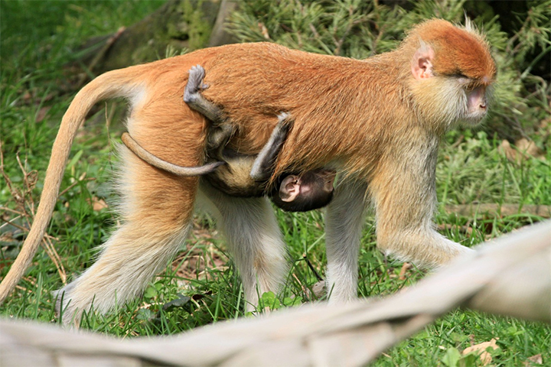
The Simplest Spiritualty -Surrender into the Universe
Learn to Surrender to The Universe
Baby Monkey Holding on to Mother Monkey

Slide 51
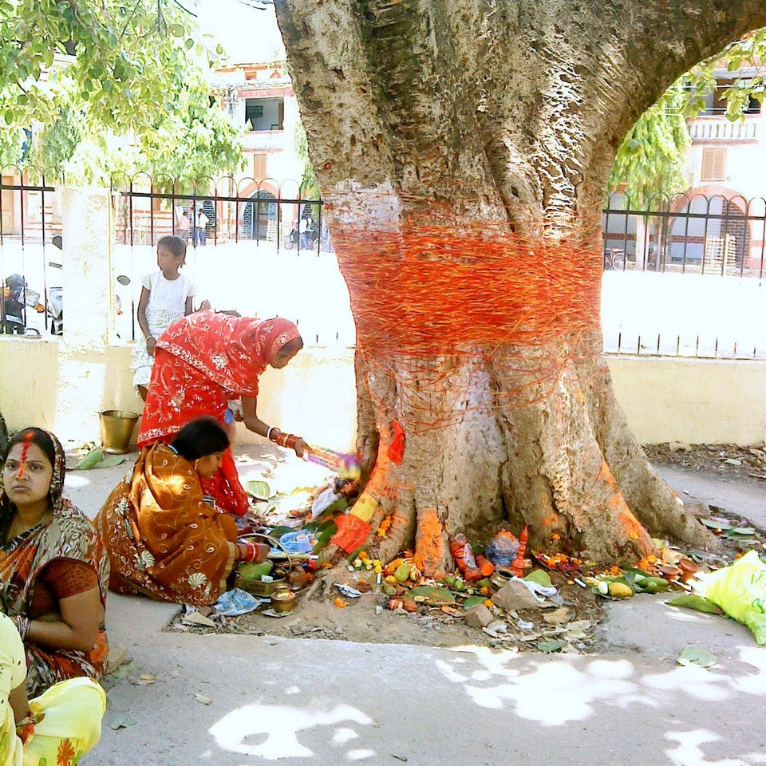
Unconditional Giving Opposite of Ego
When someone gives you something spontaneously, without expecting anything in return, this leaves a powerful impression.
Giving, Empathy, caring sharing - gateways to a high EQ.
Why People Worship trees in India- Giving is a great spiritual value

Slide 52
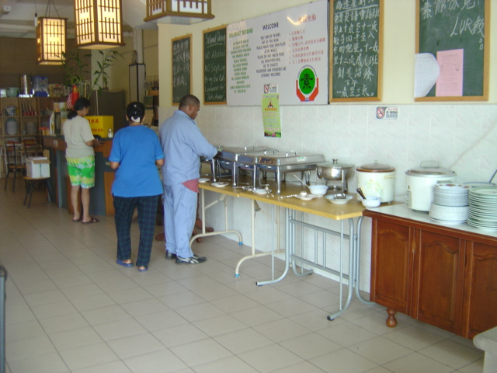
Restaurant No 72
Art of Giving

Slide 53
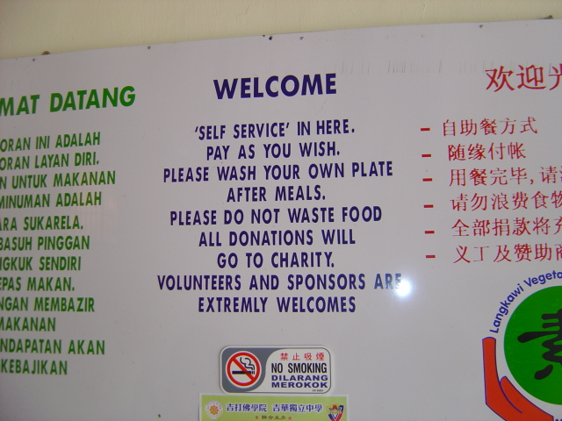
Restaurant No 72
Art of Giving

Slide 54
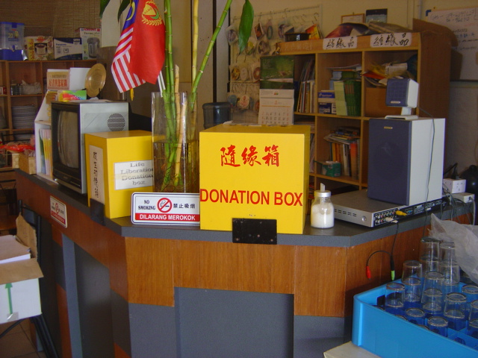
Restaurant No 72
Art of Giving

Slide 55
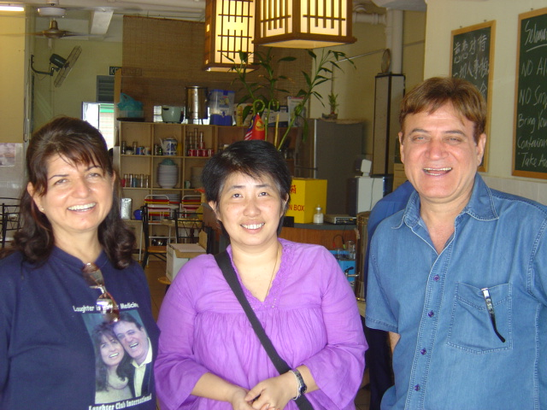
Restaurant No 72
Art of Giving

Slide 56
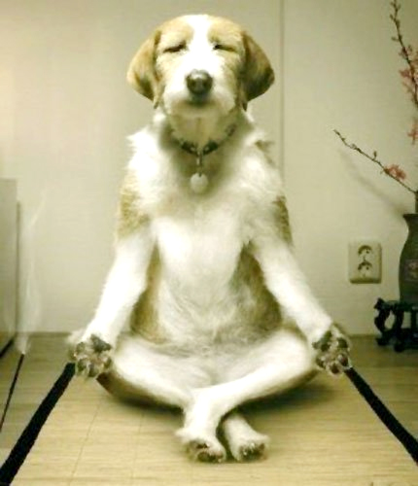
Meditate and Recharge
Two types of Meditation
Dynamic
Still Meditation

Slide 57
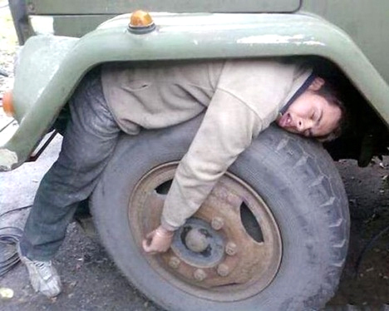
You Get Enough Sleep
Sleep is Nature’s Recharge Mechanism
REM and DEEP Sleep
YOGA NIDRA
Quick Recharge Mechanism

Slide 58
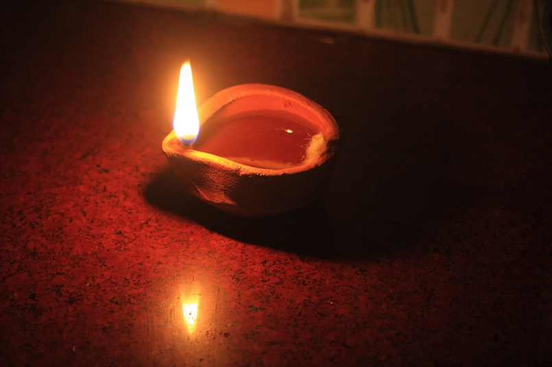
Don’t Remove The Darkness – Light a Lamp
The Ancient Indian Wisdom

Slide 59

You Embrace Change- Be Flexible like River
Emotionally intelligent people are flexible and are constantly adapting. They know that fear of change is paralyzing and a major threat to their success and happiness.
They look for change that is lurking just around the corner, and they form a plan of action should these changes occur

Slide 60
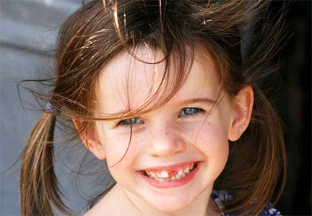
What Do You See In This Picture

Slide 61
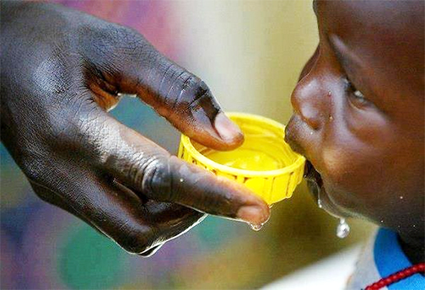
Appreciate What You Have
People who worked daily to cultivate an attitude of gratitude experienced improved mood, energy, and physical well-being.
It’s likely that lower levels of cortisol played a major role in success.

Slide 62
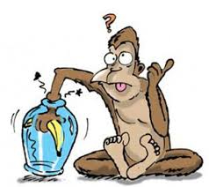
Don’t Hold Grudges Let Go
Hatred is like a poison you are drinking expecting other person to die- Gandhi
Learning to Let go Forgive and forget
How People catch Monkeys in India

Slide 63
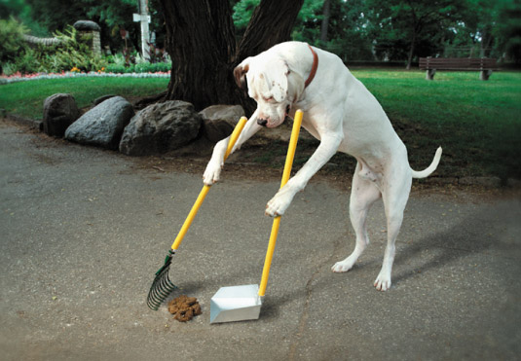
Any Shit in your Life – is a Step Forward to Greatness
Difficulties and Challenges
Will make you strong
Convert Frustrations
Into Fascinations
Convert Scars into Stars

Slide 64
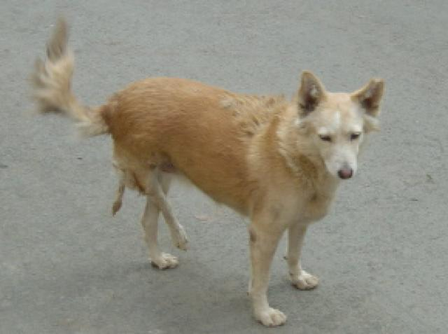
So What?? Mantra from Yamma Gucchi
You have many problems in life
Learn from Yamma Gucchi

Slide 65

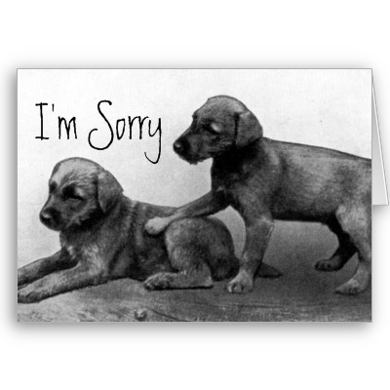

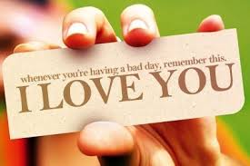
Two Magic words for high EQ
APPRECIATION & FORGIVENESS

Slide 66
5 Key Skills you can Get with LY for EQ
Get rid of old baggage : Catharsis letting go of old baggage
Quick Stress Reduction- Quick tool to reduce stress
Creativity : Play is essential skill for creativity.
Positive mental State change the chemistry to change the thoughts and hence your perception Optimism and Hope.
Practice spiritual values virtues : Truthfulness honesty generosity forgiveness
EMOTIONAL CLEANSING EXERCISE: Slower Longer Deeper BREATHING

Slide 67
Dr. Madan Kataria
Founder Laughter Yoga Movement
Mob: +91 9819822226
http://www.laughteryoga.org
http://www.youtube.com/laughteryoga
http://www.facebook.com/laughteryoga

