Slide 1

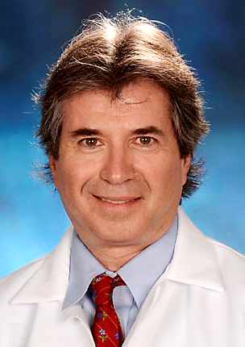
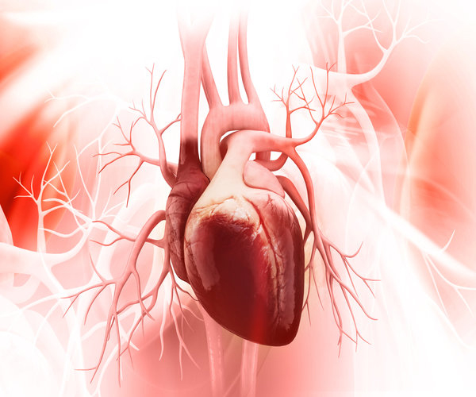
Can Laughter Yoga
Heal Your Heart?
Michael Miller, MD, FACC, FAHA
Professor of Cardiovascular Medicine,
Epidemiology & Public Health
University of Maryland School of Medicine
www.drmichaelmiller.org

Slide 2
Cardiovascular Risk In The 21s Century-
STRESS: The Missing Link
Risk
Smoking
Lipids
High Blood
Pressure
Diabetes
Stress

Slide 3
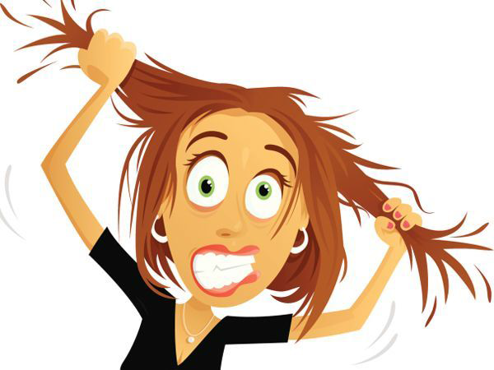
The Biology of Stress

Slide 4
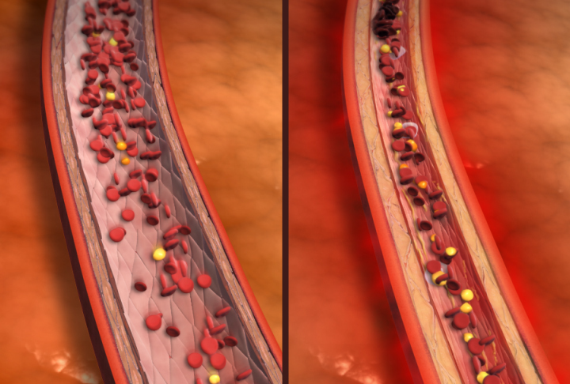
The Biology of Stress
Blood Vessels Constrict

Slide 5
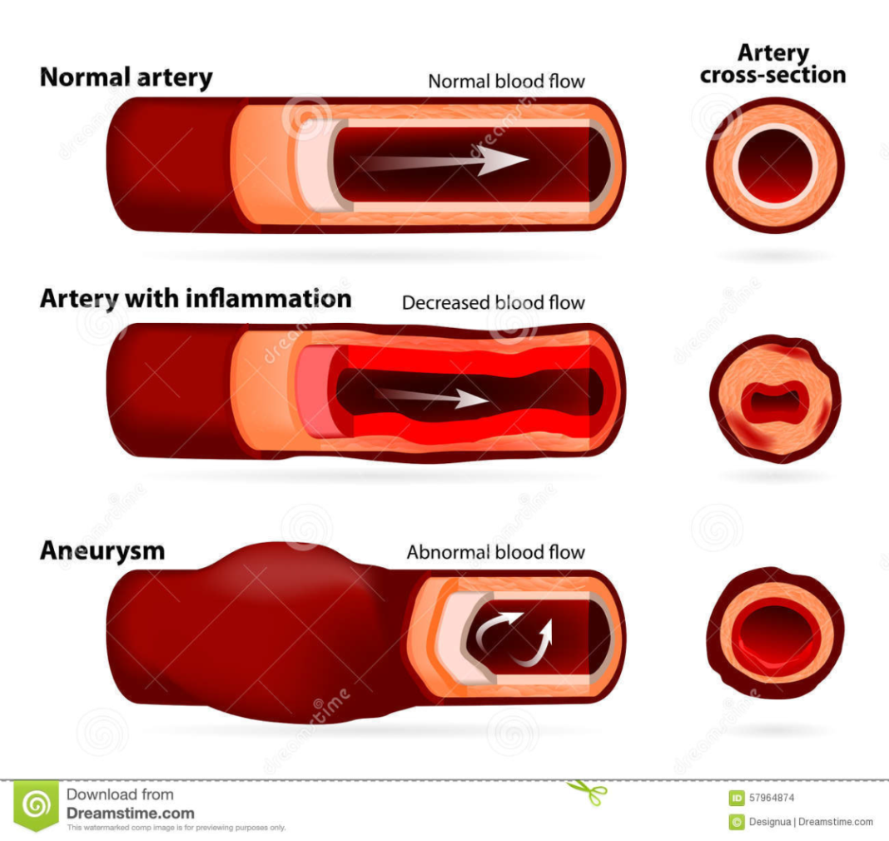
The Biology of Stress
Blood Vessels become Inflamed

Slide 6
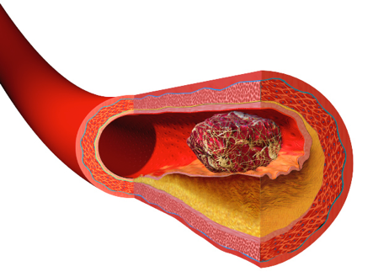
The Biology of Stress
“The Clot Thickens”

Slide 7
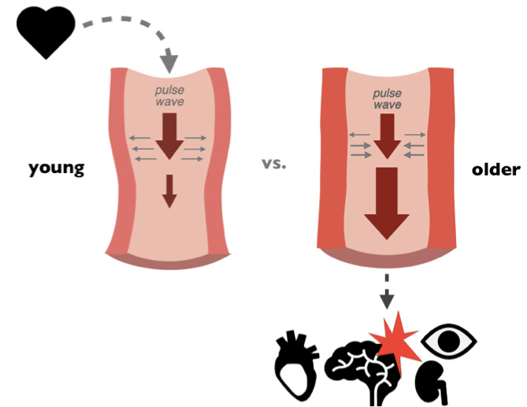
The Biology of Stress
Blood Vessels Age

Slide 8
How Laughter Yoga
Heals Hearts
Biological Effects of Laughter

Slide 9
Your Artery after…
Laughter Stress
Heart 2006; Psychosomatic Medicine 2010; Am J Cardiol 2011

Slide 10
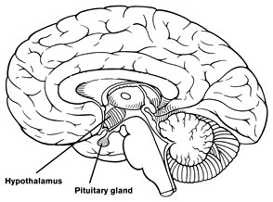
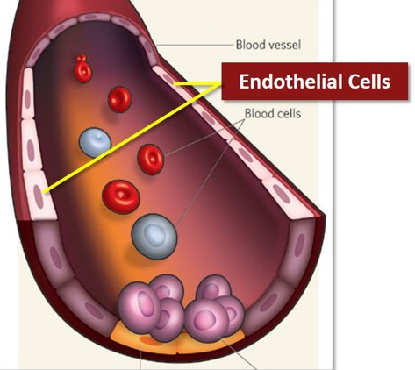
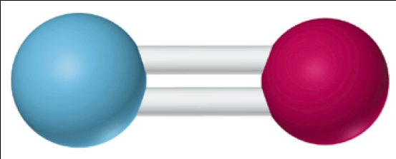
Effect of Laughter Yoga on Blood Vessels
Hypothalamus
Pituitary Gland
Pituitary Hypothalamus
Platelet aggregation
Beta Endorphins ( Other opioids )
Blood vessel dilation
Inflammation
Receptor Activation
Nitric Oxide
Endothelium

Slide 11

Changes in blood pressure from baseline
after three weeks of laughter yoga
Measurement | Laughter yoga group (n=200) | Control group (n=100)
Pretreatment systolic blood pressure (mm Hg) | 128.24 | 125.89
Posttreatment systolic blood pressure (mm Hg) | 120.78a | 125.96b
Change (%) | -6.18 | 0.06
Pretreatment diastolic blood pressure (mm Hg) | 82.37 | 82.34
pressure (mm Hg) | 79.34a | 81.8 b
Change (%) | -3.82 | -0.65
a. p<0.001 paired t test pretreatment compared with posttreatment; p<0.05
independent t test comparison between laughter yoga and control group
b. p=NS difference between pretreatment and posttreatment
Chaya MS et al American Society of Hypertension 2008. Annual Meeting; May 14, 2008; New Orleans, LA.

Slide 12
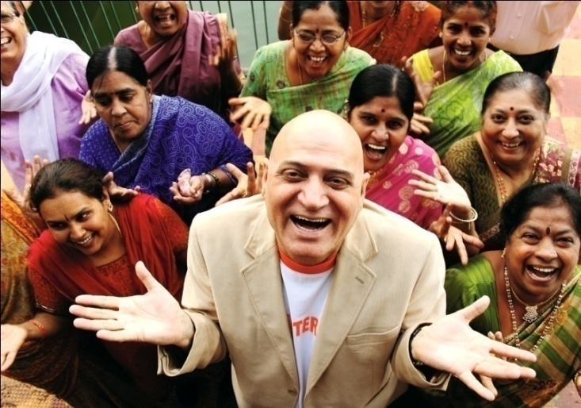
Laughter Yoga:
Heart Disease & Stroke
Japanese Cross Sectional Study (n=20, 934; 65+ years)
Never/Rarely laugh vs daily laughter
20% Increase in Heart Disease:
60% Increase in Stroke
Hayashi K, et al. J Epidemiol 2016 doi:10.2188

Slide 13
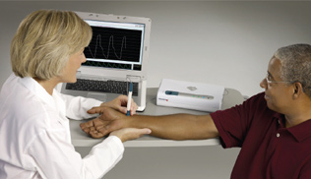
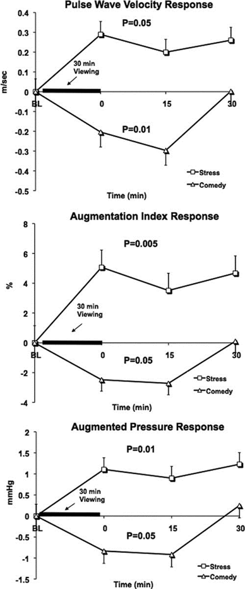
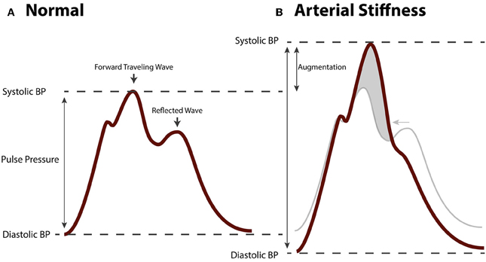

Laughter Reduces Aging of Blood Vessels

Slide 14
Biological Effects of Stress
Bottom Line
Blood Vessels Constrict
Blood Vessels become Inflamed
The Clot thickens
Blood vessels age with rigidity

Slide 15
Biological Effects of Laughter/LY
Bottom Line
Blood Vessels Dilate
Blood Vessels Chill
The Clot does NOT thicken
Blood vessels remain elastic and youthful

Slide 16
How Laughter Yoga Heals Hearts
Biological Effects of Laughter
Physical Effects of Laughter Yoga

Slide 17
Laughter & Calories Burned
10 min of laughter ~10-20 calories
(Buchowski MS, Int J Obes 2007)
30-40 min Laughter Yoga session~100-200 calories

Slide 18
How Laughter Yoga Heals Hearts
Biological Effects of Laughter
Physical Effects of Laughter Yoga
Social Effects of Laughter Yoga

Slide 19
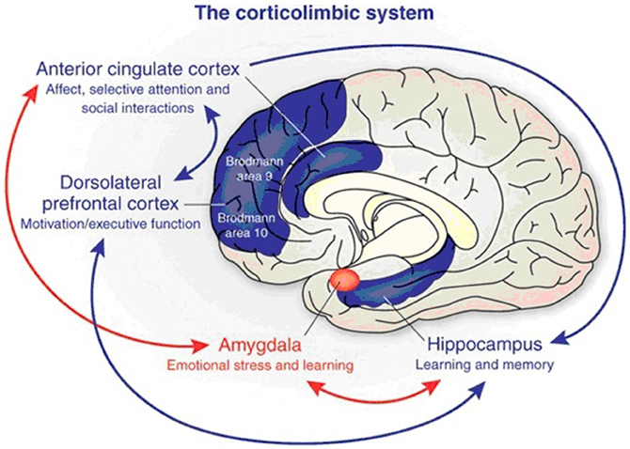
Amygdala:
The Brain’s Emotional Coding Region

Slide 20
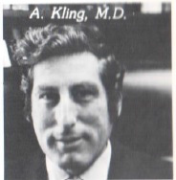

Pioneers of Emotional Health:
Arthur Kling, MD
Psychiatrist
Robert Deutsch, PhD
Cognitive Anthropologist

Slide 21
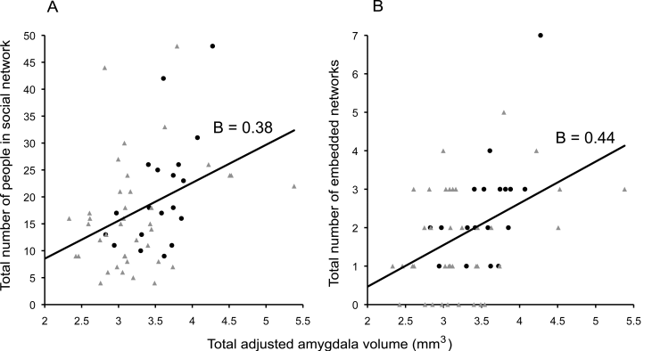
Amygdala & Social Connections:
Amygdala Volume Correlates with Social Connections
Bickart KC, Nat Neurosci. 2011;14d:1oi6:130-.140

Slide 22

“Broken Heart Syndrome”
Severence of a Critical Social Connection
Esler, M., Mental stress and human cardiovascular disease. Neurosci.
Biobehav. Rev. (2016), http://dx.doi.org/10.1016/j.neubiorev.2016.10.011

Slide 23
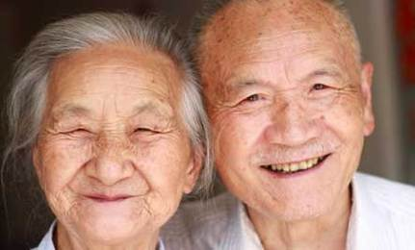
Okinawan Centenarians (Japan)
High Level Social Connections

Slide 24
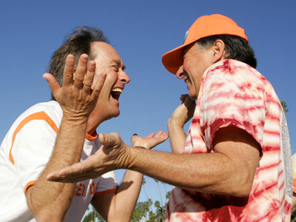
Laughter Yoga:
High Level Social Connections

Slide 25
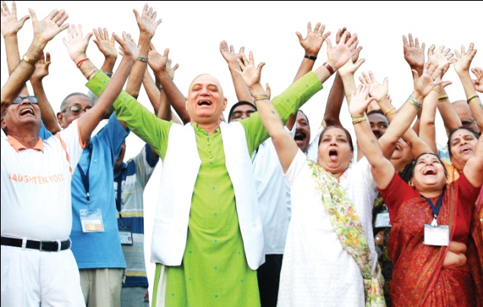
Laughter Yoga:
High Level Social Interactions
Improves Heart Rate and Artery Flexibility
(HRV) for Transplant Patients
(Dolgoff-Kaspar R, Altern Ther Health Med 2012)
Improves Mood with Parkinson’s Disease
(DeCaro DS, Explore 2016)
Improves Mood with Kidney Disease (dialysis)
(Bennett PN, Sem Dialysis 2014)

Slide 26
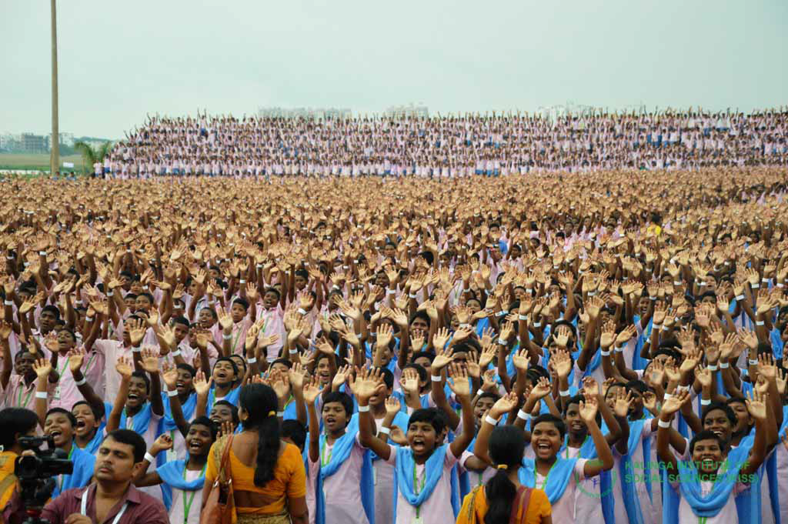
Laughter Yoga:
Guinness Book of World Records

Slide 27

Most Consecutive Years Teaching (78 years)

Slide 28
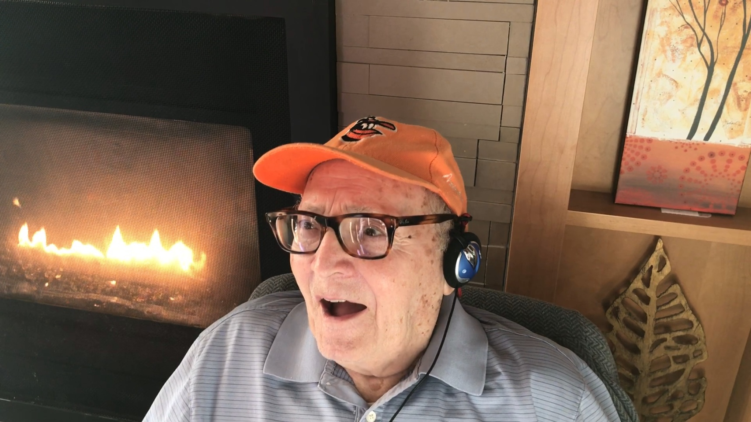
Sage Advice from a 101 year old
“Never too old to start Laughter Yoga”

Slide 29
